Slide 1




2
Unit 7 Section A
Women at the Management Level
FOREIGH LANGUAGE TEACHING AND RESEARCH PRESS
AIR FORCE ENGINEERING UNIVERSITY
Notes:
1

Slide 2
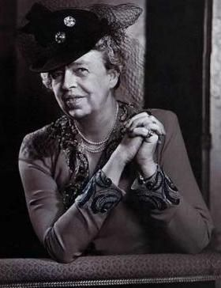
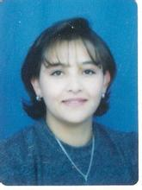
2
7
Women: Making a difference
7
UNIT
UNIT
Because I am a woman, I must make unusual efforts to succeed. If I fail, no one will say, “She doesn’t have what it takes.” They will say, “Women don’t have what it takes.”
— Clare Boothe Luce
Being a full-time mother is one of the highest salaried jobs in my field, since the payment is pure love.
— Mildred B. Vermont
Notes:
2

Slide 3

^{Section A}
2
7
Women: Making a difference
UNIT
Women at the Management Level
To talk about woman in the workplace
Objectives
To further understand the text
To apply the phrases and patterns
To master the sample essay writing skill

Slide 4






A
Women at the Management Level
SECTION
Contents
Warming-up Activities
Text Study
Language Application
Summary

Slide 5




A
Women at the Management Level
SECTION
Warming-up Activities
Lead-in
Pre-reading Activities
Cultural Background

Slide 6

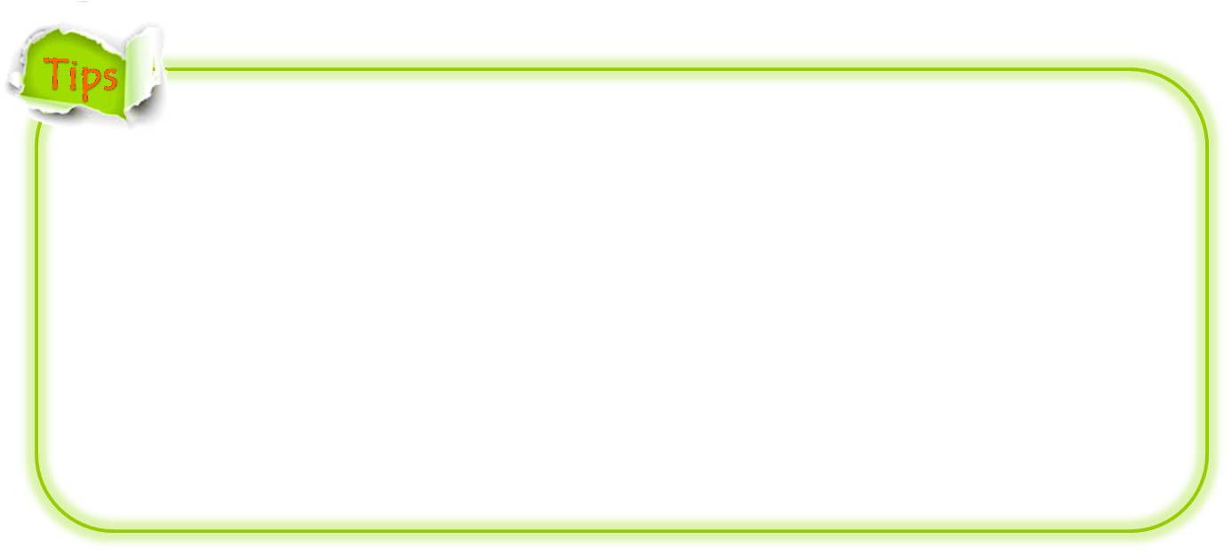
1. What is career woman?
pursue a career to make a living
work for a salaried living
seek for personal advancement
remain independent by seeking a career as a working woman
would rather work than being a housewife without occupation

Slide 7
2. Should women stay home or work outside? Why?
Stay home:
To take good care of children and parents
To manage the household affairs

Slide 8
2. Should women stay home or work outside? Why?
Work outside:
To acquire more knowledge in different aspects
To broaden the horizon and enrich the mind
To develop the creative thinking ability
To make more new friends
To participate in more social practice

Slide 9
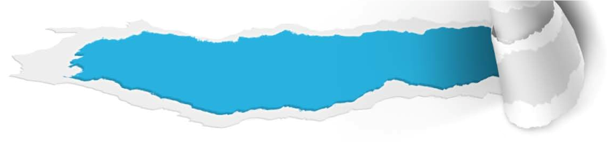
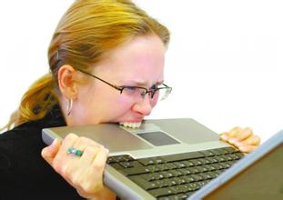


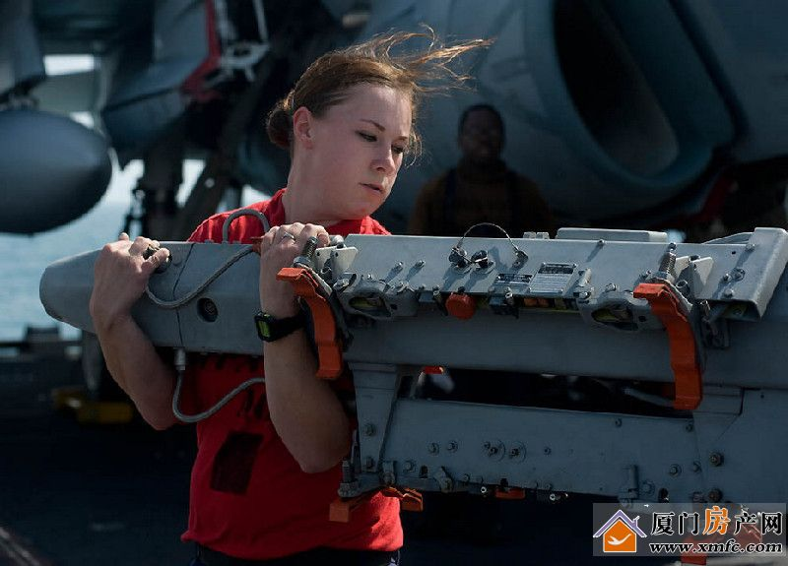
Pre-reading Activities
Look and Talk
Look at the set of pictures regarding the topic of women and workplace. Use an adjective to describe each picture and discuss the questions.
overwhelmed
/ frustrated
happy
confident / contented
strong

Slide 10

Pre-reading Activities
Look and Talk
Please discuss the following questions:
Q. What are the advantages and disadvantages for the career woman?
Notes:
10

Slide 11
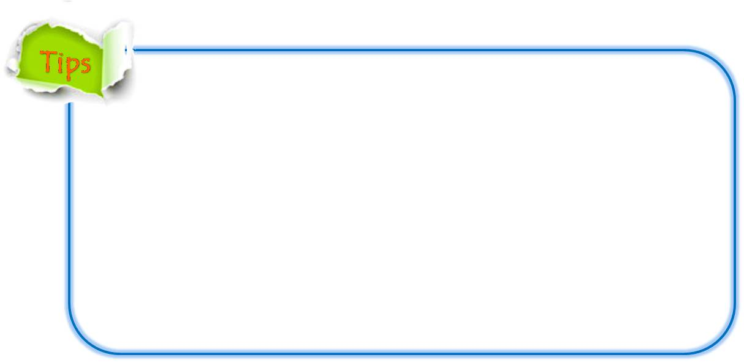
Pre-reading Activities
Look and Talk
Q. What are the advantages and disadvantages for the career woman?
Disadvantages:
face gender discrimination
get lower pay than man
face a double standard of the behavior of men and women
can’t strike a balance between work and family life without making many sacrifices
face the stereotyped “bimbo” title for women
easy to get wrapped up in seeing another woman as a threat

Slide 12
Pre-reading Activities
Look and Talk
Q. What are the advantages and disadvantages for the career woman?
Advantages:
have different values from men’s
have confidence
be perseverant
have intuitive ability in bringing in all points of view / stronger with networking, sponsoring and supporting each other
Notes:
12

Slide 13
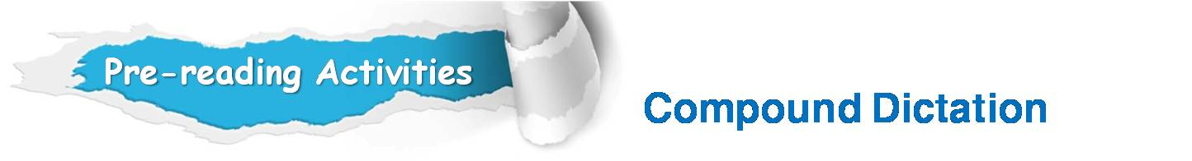


Listen to a short passage concerning woman’s place in society and fill in the missing information.
Researchers have done some ______________ into what young people believe is a woman’s place in society. Here is a report on some of their findings.
investigation

Slide 14
Listen to a short passage concerning woman’s place in society and fill in the missing information.
consistent
The Chinese are __________ supporters of sex __________ with only 12% of young people believing that a woman’s place is in the home. 93% are _____________ about sharing the housework and 85% of them believe that women should be paid the same for doing the same job.
equality
enthusiastic
Notes:
14

Slide 15
Listen to a short passage concerning women’s place in society and fill in the missing information.
80% think that ________ is a woman’s job and 90% of them believe that ________ is only men’s job. 13% of Chinese, an extremely low percentage, believe cooking is ________ a woman’s job and 7% , even fewer, think that only she should do the washing.
nursing
mining
solely
Notes:
15

Slide 16
Listen to a short passage concerning woman’s place in society and fill in the missing information.
80% of ________ believe men and women should get the same pay for the same job. 39% believe a woman’s place is in the home. 75% of them believe that housework should be shared between men and women if both work, but there’s almost a complete _________when it comes to doing the washing and cooking.
Koreans
reversal
Notes:
16

Slide 17
Listen to a short passage concerning woman’s place in society and fill in the missing information.
Here, very few believe in sharing the work. 62% and 65% _____________ believe that women should do both. 85% of Koreans believe nursing is a woman’s job and 87% think mining is a man’s job.
respectively
Notes:
17

Slide 18

Cultural Background
Women in the workplace
Questions Previewing
Q1: What do you think about women’s role in today’s workplace?
Tips
Q2: Do you agree that the cooperation of men and women can bring benefits at the workplace?
Tips

Slide 19



Cultural Background
Women in the workplace
Q1: What do you think about women’s role in today’s workplace?
be a strong force in the workplace;
filling the ranks in many professions and many top companies;
Gone are the days of men working outside and women staying at home;
Many of today’s global business leaders and powerful entrepreneurs are women.

Slide 20
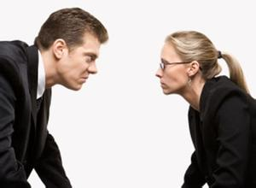
Cultural Background
Women in the workplace
Q2: Do you agree that the cooperation of men and women can bring benefits at the workplace?
The data supports the benefits of gender diversity at the workplace.
The survey shows: companies with the highest percentages of women in their executive ranks achieved 35% higher returns on equity and 34% better total return to shareholders than comparable companies with fewer females.

Slide 21


A
Women at the Management Level
SECTION
Text Study
Main Idea & Structure
Language Focus
Critical Thinking

Slide 22
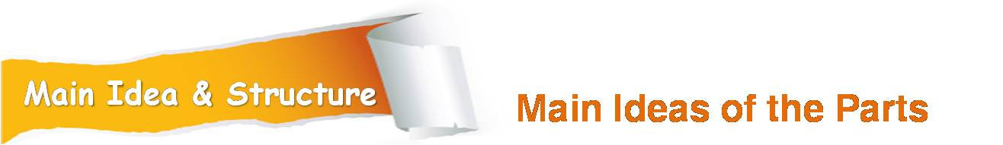

The text is a ______________ on_______________
in the workplace.
feature report
female bosses
1. Why did Monica change her idea 20 years later when she was asked the same question whether she would work for a male or a female attorney? (Para.1)
Female bosses are much more accessible to their employees and much more sensitive and intimate with their employees.
Tips
Notes:
22

Slide 23
2. Why are female bosses today still finding they face subtle resistance? (Para.2)
Tips
There are still some people who report that they have a low tolerance for female bosses.
Notes:
23

Slide 24

Part I — (Paras. 1- __)
2
Part I serves the introduction of the reading. The first paragraph starts with _____________. 20 years later, she changed her _________for working for a male boss to a female boss. The second paragraph_________________ concerning working styles: Do men and women manage differently?
Monica’s story
preference
raises the question

Slide 25
3. Based on the text, what kind of working style does Monica have? (Para.3)
How female bosses manage?
Tips
more flexible, understanding, willing to give power to others and seek consensus.
Notes:
25

Slide 26
Part II — (Para.3)
Part II (Para.3) presents the ________________ of a female boss:____________ and always _________________. As a result, employees are _________________ because they have ___________________ instead of being__________________ ; their energies are put to use. On the other hand, consensus takes longer.
unique working style
delegate power
look for a consensus
happy and flourish
input into decisions
passive bystanders
Notes:
26

Slide 27
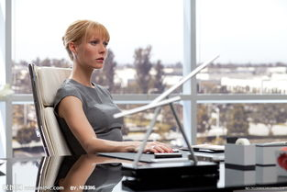
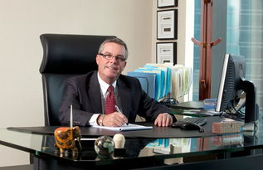

4. What does research say regarding the different working styles between men and women? (Para.4)
Diplomatically
/Share power
Typically hierarchical
/Goal-oriented
/Feel entitled
Notes:
27

Slide 28
5. What happens when both men and women are working for a female boss? (Para.5)
Tips
While women may feel more comfortable with a female boss, men often have to spend a long time making concessions to the new working styles.
Notes:
28

Slide 29
Part III — (Paras. 4-__)
5
Part III explores the _________ in working styles between male and female bosses. Men are ____________. goal-oriented and feel __________while women manage skillfully and ___________. When women work for women, women usually feel more ____________ their female boss, but it takes _________ for men to feel comfortable around their female boss.
differences
hierarchical
entitled
diplomatically
at ease with
long time
Notes:
29

Slide 30

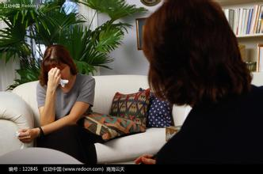
6. What’s implied from the example of women’s tears and men’s feeling toward their tears? (Para.6)
Tips
Their entirely different ways of thinking, and their opposite attitudes toward the same situations.
Notes:
30

Slide 31
7. Who is Deborah? (Para.7)
Tips
Deborah is the president of a firm with its headquarters in Toronto.
Notes:
31

Slide 32
8. According to Deborah, why is her authority sometimes undermined by perceptions about her gender? (Para.8)
Tips
It stems from the whole social context of traditional roles for men and women. Men are more authoritative, thus demanding more power than women.
Notes:
32

Slide 33
Part IV — (Paras. 6-__)
8
Part IV analyzes reasons why male and female bosses manage differently. It uses the example of a female vice-president, who ____________ at a meeting because she felt angry, but men don’t ___________. The difference stems from the whole ___________ of traditional roles for men and women.
burst into tears
understand
social context
Notes:
33

Slide 34
9. What’s the obstacle for female bosses? (Para.9)
Tips
For female bosses, the great expectation of some female employees is one more obstacle.
Notes:
34

Slide 35
Part V — (Para.9)
Part V discusses the obstacles a female boss also faces: Female employees expect their female boss will ____________ them more quickly; on the other hand, they hope their female boss can ___________ her own work without bothering them.
promote
take care of
Notes:
35

Slide 36
10. What can you infer from what Nina says about the best management styles? (Para.10)
Tips
Women could be perceived to work together with men to create the best management style.
Notes:
36

Slide 37
Part VI — (Para.10)
Part VI concludes the feature report. The author is rather ____________ about the future, hoping the day will ___________. when people recognize the best management styles are ___________ of both male and female.
optimistic
come soon
composed
Notes:
37

Slide 38
Main Idea & Structure
Structure of the Text
Introduction
Examples
Conclusion

Slide 39
Main Idea & Structure
Structure of the Text
Introduction:
Female bosses in the workplace
Monica’s story: 20 years later, she changed her preference from working for a male boss to a female boss. (Para. 1)
Raise the question: Do men and women manage differently? (Para. 2)

Slide 40
Main Idea & Structure
Structure of the Text
Why male and female bosses manage differently? (Paras. 6-8)
What are the obstacles for female bosses? (Para. 9)
How male and female bosses are different in working styles? (Paras. 4-5)
How female bosses manage? (Para. 3)
Examples to illustrate each sub-points

Slide 41
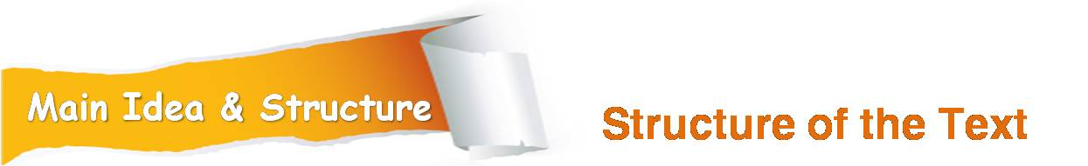
Conclusion
The day when the best management styles are composed of both male and female will come soon. (Para. 10)

Slide 42
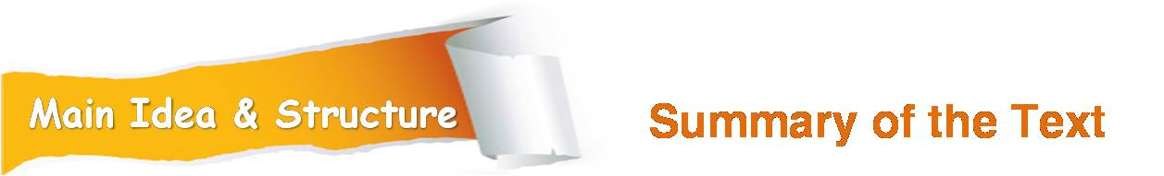
Women at the management level
When Monica applied for a job as an ___________________ , she preferred to work for a male __________ , as female bosses are much more ___________, more sensitive and ____________their employees.
administrative assistant
attorney
accessible
intimate with
To be continued

Slide 43
The female bosses’ working style is more ___________, more ____________, more team-oriented, and they tent to _________________ and always look for a ______________ . As a result, employees are happy and _____________ because they have _________________instead of being __________________; their energies are put to use.
flexible
understanding
delegate power
consensus
flourish
input into decisions
passive bystanders
To be continued

Slide 44
According to ____________ studies, men are _________________ , goal-oriented and _____________ while women manage ___________ and skillfully. The difference ___________ the whole social context of traditional roles for men and women. Men are more ______________ than women, thus demanding more power than women.
plausible
typically hierarchical
feel entitled
diplomatically
stems from
authoritative
To be continued

Slide 45
Though a few decades ago there were fewer female bosses in leading positions, women could now be _________________ to work together with men to create the best management style.
perceived

Slide 46
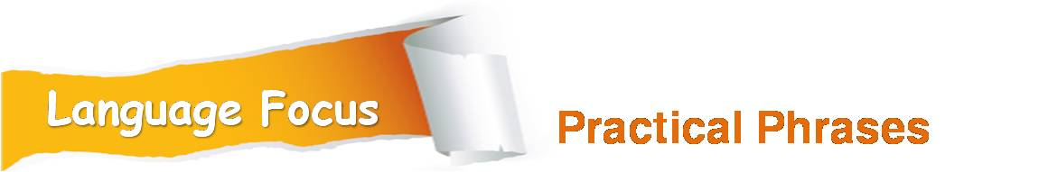
Practical Phrases | Specific Meanings
1. be disposed to do sth. | 愿意做某事；乐于做某事
2. on both counts | 在两个方面
3. feel at ease with sb. | 感到放松，不拘束
4. make a concession / concessions to | 为对某事或某想法取得一致意见作出妥协
5. come down to | 归结为
6. take exception to sth. | 因某事而生气
7. burst into | 突然迸发

Slide 47

愿意做某事；乐于做某事
be disposed to do sth.
短语逆译
短语应用
尽管父母反对，他反复强调他也乐意留下来。
意群提示
(despite of parents’ disapproval )
Despite of his parents’ disapproval, he repeated that he would also be disposed to stay.

Slide 48
在两个方面
on both counts
短语逆译
短语应用
我原以为他是个善良、诚实的人，但这两点我都想错了。
意群提示
(take it for granted that )
I took it for granted that he was a kind and honest person, but I was wrong on both counts.

Slide 49
（与某人在一起）感到放松，不拘束
feel at ease with sb
短语逆译
短语应用
与教师相处融洽有助于学习过程。
意群提示
(learning process /be facilitated)
The learning process will be facilitated if you feel at ease with your teacher.

Slide 50
为对某事或某想法取得一致意见作出妥协
make a concession /concessions to
短语逆译
短语应用
为了达成和解并继续往常的业务，我们公司已对他们作出妥协。
意群提示
(reach a settlement / as usual)
Our company has made a concession to them in order to reach a settlement and to continue with business as usual.

Slide 51
come down to
归结为
短语逆译
短语应用
我们能不能去欧洲度假的决定最终都归结到钱，即我们能有多少钱。
意群提示
(whether or not/ go on a vacation/ can afford)
The decision whether or not we can go on a vacation to Europe comes down to money in the end; that is, how much money we can afford.

Slide 52
因某事而生气（烦恼）
take exception to sth.
短语逆译
短语应用
由于在社交网络上没有隐私可言，我们对自己受到监视很生气。
意群提示
(no privacy /social networks / be spied on)
As there is no privacy in social networks, we take exception to being spied on.

Slide 53
突然迸发（尤指开始唱歌、哭、笑等）
短语逆译
burst into
短语应用
操场的对面，传来一个好消息，所有的人都激动起来。
意群提示
(across playground )
Across the playground came a good news and all the people burst into excitement.

Slide 54

Functional Patterns | Functions & Usages
1. sb. would rather do sth. | 表达优先选择的一种方式，“表示宁愿；宁可；还是…为好”，后接动词原形
2. sb. do sth., by contrast, sb. else do sth. else. | “表示与…相比之下” ，用于对比，以显示出两人或事物的差异。
3. Some proclaim / announce / reveal / state / propose / indicate / post / declare… | “表示某人宣称…(持有…样的观点)”，用来提出某人的立场、观点、想法等
4. There is no dispute that… | “用来表示对某事没有争议”
Notes:
54

Slide 55
原句译文
1971年，莫妮卡申请一个行政助理的工作时，她被问到：想与男律师共事还是与女律师共事。
逆译练习
When Monica applied for a job as an administrative assistant in 1971, she was asked whether she would rather work for a male or a female attorney. (Para.1. L.1)
句型提炼
Notes:
55

Slide 56
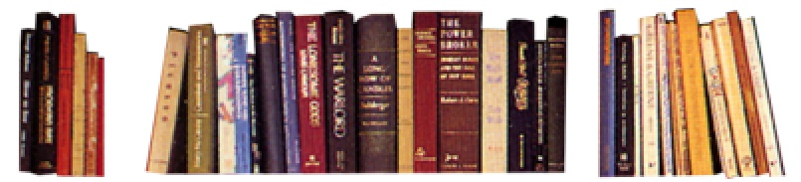
句型提炼
sb. would rather do sth.
应用提示
表达优先选择的一种方式，“表示宁愿；宁可；还是…为好”，后接动词原形
句型应用
Notes:
56

Slide 57
典型例句
如果你宁愿独自呆着，那我们如你所愿都离开这儿。
意群提示
(be alone / as you please)
If you would rather be alone, we’ll all leave here as you please.

Slide 58
原句译文
相反，女人则是灵活变通的，愿意分享权力。
逆译练习
Women, by contrast, manage diplomatically, and share power. (Para.4. L.2)
句型提炼
Notes:
58

Slide 59
句型提炼
sb. do sth., by contrast, sb. do sth. else.
应用提示
“表示与…相比之下” ，用于对比，以显示出两人或事物的差异。
句型应用
Notes:
59

Slide 60
典型例句
她考试差点不及格，相比之下，她的妹妹考得很好。
意群提示
( failed the exam)
She had almost failed the exam, but her sister, by contrast, had done very well.

Slide 61
原句译文
有人宣称：有着类似背景、经验和抱负的男性和女性，基本上以同样的方式来进行管理。
逆译练习
Some proclaim that men and women of similar backgrounds, experience and aspirations basically manage in the same way. (Para.4. L.4)
句型提炼
Notes:
61

Slide 62
句型提炼
Some proclaim / announce / reveal / state / propose / indicate/ declare …
应用提示
“表示某人宣称…(持有…样的观点)”，用来提出某人的立场、观点、想法等
句型应用
Notes:
62

Slide 63
典型例句
在法庭上，被告宣称自己是无辜的。
意群提示
(the accused / innocent / not guilty)
At the court, the accused proclaimed that he was innocent / not guilty.

Slide 64
原句译文
另一方面，几十年前她们工作的地方几乎不可能有女上司，这一点毫无争议。
逆译练习
On the other hand, there is no dispute that a few decades ago they would rarely have had a female boss in the workplace. (Para.10. L.1)
句型提炼
Notes:
64

Slide 65
句型提炼
There is no dispute that…
应用提示
表示“对某事没有争议”。
句型应用
Notes:
65

Slide 66
典型例句
这是不争的事实：家人和亲属是居家老人的主要支持来源。
意群提示
(primary source / senior people)
There is no dispute that family and relatives are the primary source of support for senior people at home.

Slide 67



大家都很开心，也有成就感，因为他们参与了决策，而不是单纯的旁观者。他们的能量得到了利用。
a. People are happy and flourish because they have an input into decisions and they are not mere bystanders; their energies are harnessed.(Para.3, L7)

Slide 68
b. Plausible studies suggest that men are typically hierarchical, goal-oriented and feel entitled. (Para.4, L1)
可靠的研究指出，男人通常有等级观念，以目标为导向，喜欢有权力的感觉。

Slide 69
虽然女性可能会觉得与女上司相处时更自然，男性却往往不得不作出改变以适应女上司新的工作作风。
c. While women may feel more at ease with a female boss, men often have to make concessions to the new working styles. (Para.5, L3)

Slide 70
“我期待某一天，在我临死之前，我们会意识到最好的管理风格是由男女双方带来的最佳组合……”
d. “I’m looking forward to the day, before I die, when we recognize that the best management styles will be composed of the best that both genders bring to the table ...” (Para.10, L3)

Slide 71


To your best knowledge, what are the differences between men and women when it comes to their respective working styles?
Tips
Whose working style do you prefer? Men’s or women’s? Why?
Tips
How would you perceive the women’s role at the management level in the future?
Tips

Slide 72

To your best knowledge, what are the differences between men and women when it comes to their respective working styles?
Men: strong, tough, stubborn, direct, hierarchical, distant, cold, impatient, rough, focus on result, goal-oriented. Men also have a strong urge to control and feel entitled.
Women: more flexible style, understanding, patient, detailed, warm, careful, considerate, indecisive, diplomatic, team-oriented.

Slide 73
2. Whose working style do you prefer? Men’s or women’s? Why?
Men’s: more direct and decisive
Women’s: more accessible and reasonable, more understanding. Woman tends to delegate more power and is always looking for a consensus. Employees are happy and flourish because they have an input into decisions and they are not mere bystanders; their energies are harnessed.

Slide 74
3. How would you perceive the women’s role at the management level in the future?
They will definitely play an indispensable role;
They will possibly outweigh men in leadership;
They will probably become tougher than before;
They will still face challenges and gender barriers.
Female boss’s authority will still be undermined sometimes by perceptions about her gender.

Slide 75

How do you understand women’s social status in the past and at present?
Aristotle, the great philosopher in Greece, once raised that the purpose for a man to marry a woman was to produce offspring, and have the wife serve his parents and manage household affairs.
In feudal China, girls had to learn to follow the “rules for women” from an early age. The Classic of Rites （《礼记》）describes that “ Boys reside in the outer part of the courtyard while girls the inner part to mind the house.”
Notes:
75

Slide 76
How do you understand women’s social status in the past and at present?
Once, girls were discriminated ever since they were born. Hundreds of years later, however, everything has changed: “women are key to our future economic growth and stability”, said Secretary of State Hillary Clinton.
Notes:
76

Slide 77

Watch a video clip and discuss some questions.
Q1. What are the main difficulties women may face in the workplace?
Q2. If you’re given a choice, would you choose a male or female boss? Why?
Tips
Video Watching

Slide 78
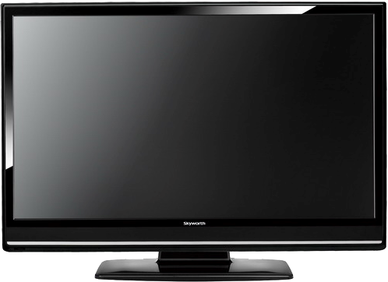
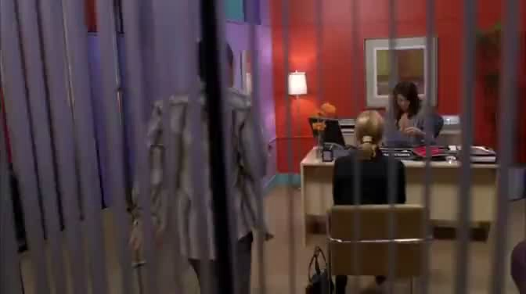
Back

Slide 79
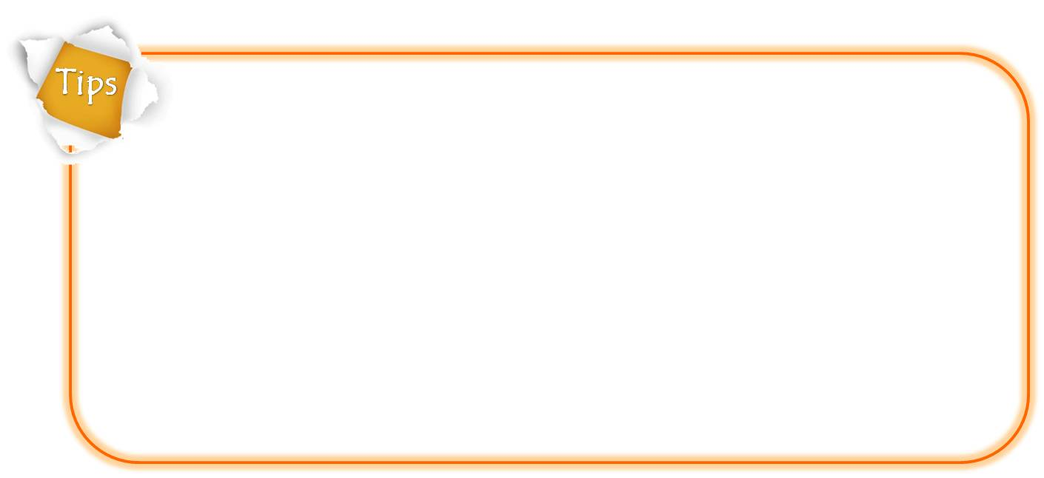
Q1. What are the main difficulties women may face in the workplace?
The road to success as a businesswoman is not an easy one.
a double standard of the behavior of men and women
gender barriers
hard to strike a balance between work and family life
a stereotyped “bimbo” title for women
to be continued

Slide 80
Q2. If you’re given a choice, would you choose a male or female boss? Why?
A male boss:
A male boss is more decisive / efficient.
A female boss is easy to get wrapped up in seeing another woman as a threat.
A female boss:
A male boss is colder / bossier.
A female boss is more reasonable / more considerate and nicer / accessible / helpful.
Notes:
80

Slide 81

A
Women at the Management Level
SECTION
Language Application
Writing Devices
Essay Writing
Paragraph Translation

Slide 82

Learn how to write an example essay ：
Features usually focus on particular people, places and events. They cover topics in depth, going further than news articles because they are not meant to report the latest breaking news but rather an in-depth look at a subject. A good feature requires many specific and lively examples, obtained from background research, interviews and observations.
to be continued

Slide 83
Learn how to write an example essay ：
In an example essay, you support your point by illustrating it with examples. How many examples you use in an example essay depends on the topic. Also, the examples you use to develop the thesis statement should be representative – fairly support your thesis.
To make examples specific and impressive, you need to use descriptive words and direct speeches.
to be continued
Notes:
83

Slide 84
Learn how to write an example essay ：
In addition, to achieve coherence in your example essay, you need to pay attention to the order of examples and proper use of transitions. The examples in an example essay can be organized according to time, familiarity and importance. Meanwhile, body paragraphs in an example essay must be connected so that they can flow smoothly. In other words, the shift from one example to the next shouldn’t be abrupt so that the reader understands clearly the progression of thought.
to be continued
Notes:
84

Slide 85




Writing Devices
Essay Writing
Learn how to write an example essay ：
Transitions to introduce examples include:
Example 1:
One example of … is …
First, consider …
To begin with, …
Example2:
Another example of … is …
An additional example is …
Second / Next, consider …
Example 3:
Still another example of … is …
Third / Finally, consider …
The most significant example of … is …
Notes:
85

Slide 86

Let’s look at Paragraph 6 from Text A to see how to support a thesis statement with a specific and detailed example:

Slide 87

To some extent, the male-female differences come down to conflicting styles. One female vice-president discussed the time she burst into tears during a meeting. “Men think that tears are a nuclear weapon in a conventional war. They take exception to a woman crying, inferring that she’s feeling unhappy or violated.” The men failed to understand that what prompted her tears was not hurt but genuine rage. “When we cry, it’s because we have all this valid rage that has no appropriate release,” she says. “Women cry; men get relief by going on with the offense or by veiling their feelings to appear composed.” (Para.6)

Slide 88
Read the sample essay and see how it develops with examples.

Slide 89
Topic:
Gender barriers still exists
Introduction:
Thesis statement: Female managers today are still facing many challenges, especially gender barriers.
to be continued

Slide 90
Body:
Example 1: A double standard of the behavior of men and women
Example 2: A stereotyped “bimbo” title for women
to be continued

Slide 91
Conclusion:
Female managers can be made to feel more insecure at work because
of gender barriers.
to be continued

Slide 92
Sample:
Throughout history, women have been hard workers who place high value on achievement. They often judge their personal worth based upon their accomplishments rather than how much money they make. At the management level, women are also considered better managers than men because of their unique working styles. However, female managers today are still facing many challenges, especially gender barriers.
to be continued

Slide 93
Sample:
To begin with, a double standard occurs when the behavior of men and women are labeled. Like it or not, we still have some notions of what is an acceptable female behavior. Those women who work extra hard, make no allowances for failure, and don’t believe in weaknesses are considered cold-hearted. When a woman shows strength of character in a meeting, for instance, she may be seen as “aggressive” whereas her male counterpart is seen as “assertive”.
to be continued

Slide 94
Sample:
An additional example of gender barriers for women in the workplace is the “bimbo” title, which is used to describe a woman who got her position by playing a game of her female tricks. For this kind of woman, she is pretty but not necessarily intelligent. So, the general concept is that women are incompetent and that they remain in the position only by means of their charm on the male bosses. But it could all be just a matter of our own perceptions of what’s normal for a man and a woman.
to be continued

Slide 95
Sample:
To conclude, female managers can be made to feel more insecure at work because of gender barriers. They have to face a double standard of the behavior of men and women; they also worry about some negative stereotypes of women.

Slide 96
Writing practice
Directions: Write an essay of no less than 150 words on one of the following topics. One topic has an outline you can follow.

Slide 97
Topic: Women’s management style
Introduction: Thesis statement: Women’s management style tends to be more communicative and relationship-oriented.
Body:
Example 1: Being more communicative
Example 2: Being more relationship-oriented
Conclusion: Women’ natural management style helps them succeed in their workplace.

Slide 98

More topics:
• Women leadership in China
• Female teacher in my eyes

Slide 99
Essay Writing
Essay Writing
Write an essay on the following topic.
Write an essay entitled with Women’s Management Style. You may apply as many expressions from the text as possible to your writing.
Notes:
99

Slide 100

Essay Writing
Essay Writing
You can follow the outline given below.
Part I. Introduction of the essay
Women are increasingly working in upper management roles;
Thesis statement: Women’s management style
tends to be more communicative and relationship-oriented.
To be continued

Slide 101

Essay Writing
Essay Writing
You can follow the outline given below.
Part II. Body part using examples to illustrate the main point.
Example 1: Women’s management style is being more communicative;
1.Their management style is being more communicative. Women usually have greater verbal and verbal comprehension ability than men.
2. They are usually more supportive, more inclined to delegate responsibilities.
To be continued

Slide 102
Essay Writing
Essay Writing
You can follow the outline given below.
Part II. Body part using examples to illustrate the main point.
Example 2: Women’s management style is being more relationship-oriented.
Women are more emotionally and spiritually intelligent.
Women have the potential to be more understanding.
To be continued
Notes:
102

Slide 103
Essay Writing
Essay Writing
You can follow the outline given below.
Part III. Conclusion
Women’s natural management style helps them succeed in their workplace;
Women are brought up to have verbal skills and emotional intelligence, which is a huge advantage.
To be continued
Notes:
103

Slide 104
Essay Writing
Essay Writing
You may adopt the following expressions.
a strong force in the workplace;
gone are the days of…;
fill the ranks in professions and top companies;
one example of…;
another example of…;
the benefits of gender diversity at the workplace;
It’s beneficial to… instead of disguising…
Notes:
104

Slide 105

Translate a paragraph based on a summary of the text by using the expressions from the text.

Slide 106
在当代社会，男人在外工作而女人待在家里的日子一去不复返了。毫无争议的是，女人在工作中的角色越来越重要。但是，今天的女上司仍然发现，她们面临着不易察觉的阻力。还是有一部分人都说很难忍受为女性工作。女上司的不断涌现，也引出了与工作方式有关的一个主要问题：男人和女人管理风格不同吗？
gone are the
days
There is no dispute
subtle resistance
low tolerance
has provoked
To be continued

Slide 107
可靠的研究指出，男人通常有等级观念，以目标为导向，喜欢有权力的感觉。相反，女人则是灵活变通的，愿意分享权力,并总是去寻求共识。这样大家都很开心，也有成就感，因为员工们参与了决策，而不是单纯的旁观者,员工们的能量得到利用。
typically hierarchical
feel entitled
diplomatically
looking for a
consensus
input into decisions
are harnessed
Samples

Slide 108
In contemporary society, gone are the days of men working outside and women staying at home. There is no dispute that women play more and more important role in the workplace. Female bosses today are still finding they face subtle resistance. There is still a segment of the population who report low tolerance for female bosses. The growing presence of female bosses has also provoked one major question that revolves around styles: Do men and women manage differently?

Slide 109
Plausible studies suggest that men are typically hierarchical, goal-oriented and feel entitled. Women, by contrast, manage diplomatically, and share power and are always looking for a consensus. Employees are happy and flourish because they have an input into decisions and they are not mere bystanders; their energies are harnessed.
Notes:
109

Slide 110

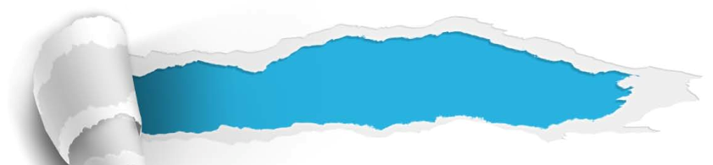

A
Women an the Management Level
SECTION
Summary
Revision of
the Useful Expressions
Thematic study
Revision of
the Functional Patterns

Slide 111
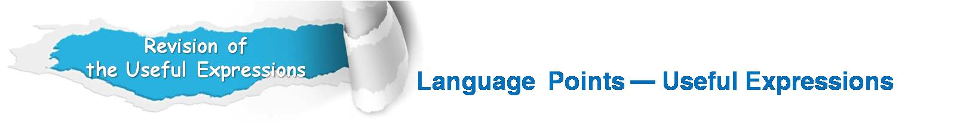
1.毫无争议的是
2.不易察觉的阻力
3.一部分人
4.很难忍受
5.可靠的研究
6.通常有等级观念
7.灵活变通的
8.寻求共识
9.参与决策
10.突然迸发
There is no dispute that…
subtle resistance
a segment of the population
low tolerance for
plausible studies
typically hierarchical
diplomatically
looking for a consensus.
have an input into decisions
burst into

Slide 112
11.为对某事或某想法取得一致意见作出妥协
12.归结为
13.源于；来自
14.乐于做某事
15.感到放松，不拘束
16.在两个方面
17.因某事而生气
18.遭受性别歧视
19.对…有更强的控制欲
20.与某人相处时太放肆
make a concession / make concessions
come down to
stem from
be disposed to do sth.
feel at ease with sb.
on both counts
take exception to sth.
encounter gender discrimination
have a strong urge to
take liberties with sb.

Slide 113
Revision of
the functional patterns
Language points—functional patterns
Functions & Usages | Sentence Patterns
“表示优先选择的一种方式”，表示宁愿,还是…为好
“表示与…相比之下” ，用于对比，以显示出两人或事物的差异
“表示某人宣称…(持有…样的观点)”，用来提出某人的立场、观点、想法等
“用来表示对某事没有争议”
sb. would rather do sth.
sb. do sth., by contrast, sb.
else do sth. else.
Some proclaim / announce / reveal / state / propose / indicate / post / declare…
There is no dispute that…
Notes:
上面挤，下面空

